Slide 1
Data Cleaning and EDA using python
By: Smith Kwabena Agyei

Slide 2
Case Study
Perform EDA and initial Cleaning on the dataset provided. Justify all choices and produce a document to be handed over to the modeling team that includes all plots, charts and deletions.

Slide 3

1
Steps Taken to Clean Data
After reading the csv file into a dataframe.
Using df = pd.read_csv('/content/raw_house_data.csv')
I had 5000 rows and 16 columns
Checked for duplicates
df.duplicated().sum() “returned 0”
Viewed the Datatypes of the Dataset
df.dtypes

Slide 4
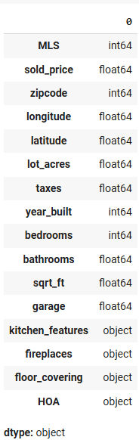
2
Data Types in the Dataset

Slide 5
3
Nulls in Dataset
I checked for the count of null values in all columns.
df.isnull().sum()
This code gave me this output which show the count of records/rows with null values based on the columns in the dataset.

Slide 6
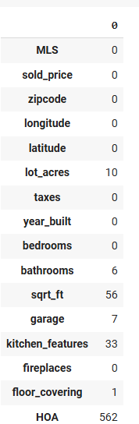
Nulls in Dataset (3. cont’d)

Slide 7
4
Remove rows with Lot_acres as null
Return indexes of Lot_acres columns with null / NaN values
vals = [np.NaN]
mask = df["lot_acres"].isin(vals)
df[mask].index
this removes all records/rows with null value in the Lot_acres column. (This is because the Lot_Acres column is not consistent with the Data) 10 records affected (4990)
df = df.drop(df.index[df[mask].index], axis=0)

Slide 8
5
Update all columns having null values
Updating some few Columns[Garage,fireplaces,HOA,Kitchen_Features,Floor_Covering] with 0 / "Nothing" where the value is null or empty
df["garage"] = df["garage"].fillna(0)
df["HOA"] = df["HOA"].fillna(0)
df["fireplaces"] = df["fireplaces"].replace(" ", 0)
updating Kitchen_features and Floor_covering to Nothing where value is null
df["kitchen_features"] = df["kitchen_features"].replace(np.NaN, "Nothing")
df["floor_covering"] = df["floor_covering"].replace(np.NaN, "Nothing")
df

Slide 9
6
Updating bathroom column with values
Fixing null / empty values for the bathroom column
zeroBathrooms = df[df["bathrooms"].isnull()]
#The immediate code snippet assigns the columns with null values for bathrooms to variable zeroBathrooms
zeroBathrooms
zBathrmsIndex = zeroBathrooms.index
#The index of the columns is stored in a variable so that the records can be accessible using their indexes
zBathrmsIndex

Slide 10
7
Updating bathroom column with values (Cont’d)
Run a loop to fill the null values of the bathroom columns
for i in zBathrmsIndex:
bathVals = df[(df["bedrooms"] == df.loc[i, "bedrooms"])][["bathrooms"]].mode()
# for every record the mode for bathrooms that have the same number of bedrooms is assigned to a variable
bathVals = bathVals["bathrooms"]
# The bathroom column of the bathVals dataframe is assigned to the variable
df.loc[i, "bathrooms"] = bathVals[0]
# The value of bathVals is assigned to the respective bathroom columns of the indexes
print(df.loc[i, "bathrooms"]) # The update values are printed out.

Slide 11
8
Updating Sqrt_ft column with values
Fixing null / empty values for the Sqrt_ft column
nSqrft = df[df["sqrt_ft"].isnull()]
#The immediate code snippet assigns the columns with null values for bathrooms to variable nSqrft
nSqrft
nSqrftIndex = nSqrft.index
#The index of the columns is stored in a variable so that the records can be accessible using their indexes
nSqrftIndex

Slide 12
9
Updating Sqrt_Ft column with values (Cont’d)
Run a loop to fill the null values of the Sqrt_ft columns
for i in nSqrftIndex:
sqrtftVals = df[(df["bedrooms"] == df.loc[i, "bedrooms"])][["sqrt_ft"]].mean() // 1 # for every record the mean for sqrt_ft that have the same number of bedrooms is assigned to a variable
sqrtftVals = sqrtftVals["sqrt_ft"]
# The sqrt_ft column of the sqrtftVals dataframe is assigned to the variable
df.loc[i, "sqrt_ft"] = sqrtftVals # The value of sqrtftVals is assigned to the respective sqrt_ft columns of the indexes
print(sqrtftVals) # The value of sqrtftVals is assigned to the respective sqrt_ft columns of the indexes

Slide 13
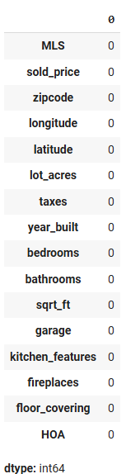
10
Sum of Nulls after Cleaning

Slide 14
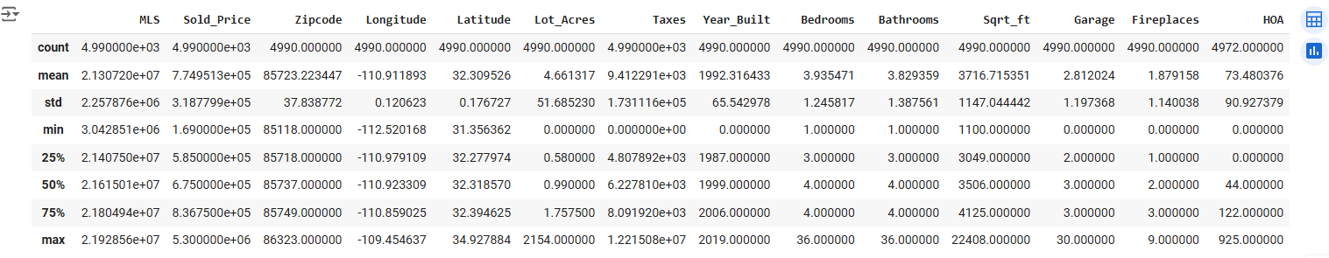
11
Aggregation and Renaming Columns
Run aggregations on the dataframe
#Renaming columns
df = df.rename(columns={'sold_price' : 'Sold_Price', 'zipcode' : 'Zipcode', 'longitutde' : 'Longitutde', 'latitude' : 'Latitude', 'lot_acres' : 'Lot_Acres','taxes' : 'Taxes', 'year_built':'Year_Built', 'bedrooms' : 'Bedrooms', 'bathrooms' : 'Bathrooms', 'sqrt_ft' : 'Sqrt_ft', 'garage' : 'Garage', 'kitchen_features' : ‘Kitchen_Features', 'fireplaces' : 'Fireplaces', 'floor_covering' : 'Floor_Covering'})
df.describe()

Slide 15
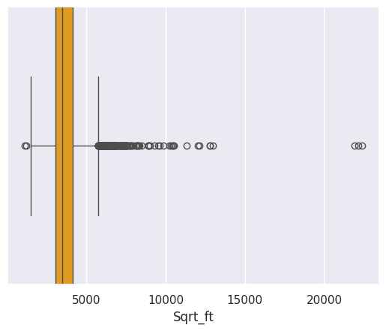
12
FINDING OUTLIERS
This Box plot is based on the Square Feet of houses sold.
sns.boxplot(df, x='Sqrt_ft', color='orange', width=1)

Slide 16
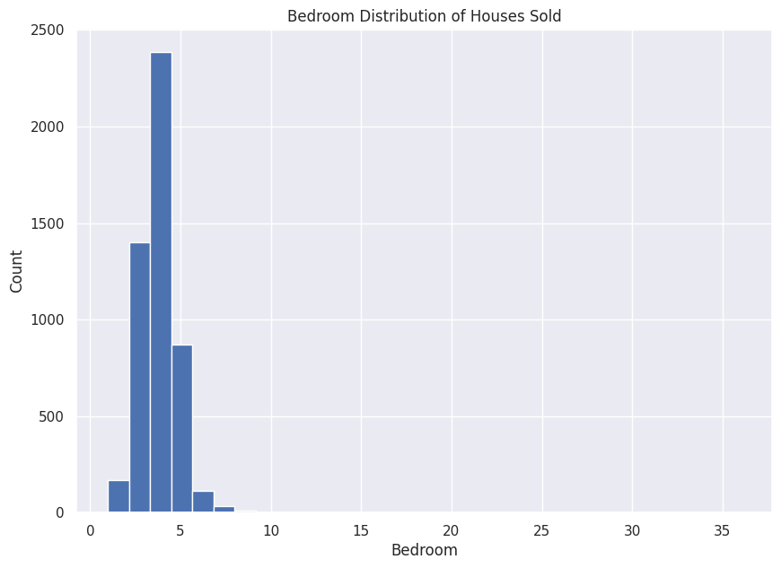
13
This Shows the count distribution of house solde based on the number of bedrooms plt.figure(figsize=(10,7))
plt.hist(df['Bedrooms'], bins=30)
plt.title('Bedroom
Distribution of Houses Sold')
plt.xlabel('Bedroom')
plt.ylabel('Count')

Slide 17
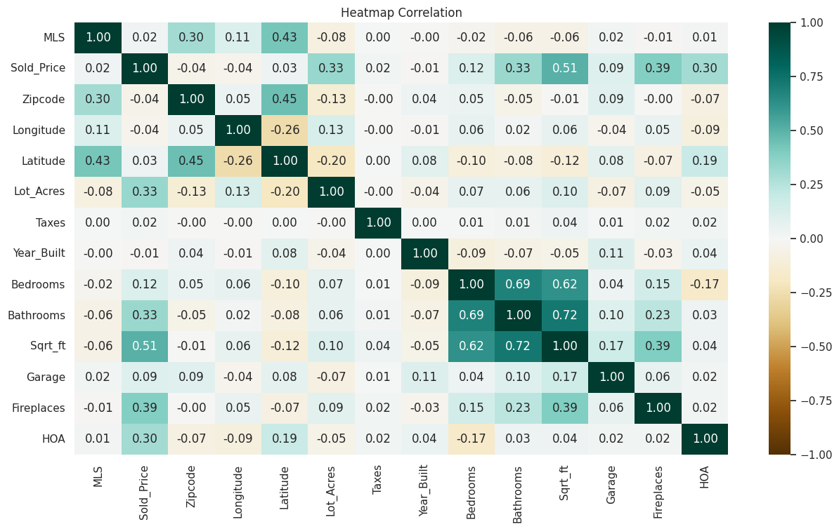
14
# Columns to generate the HeatMap on.
df = df[['MLS','Sold_Price','Zipcode','Longitude','Latitude','Lot_Acres','Taxes','Year_Built','Bedrooms','Bathrooms','Sqrt_ft','Garage','Fireplaces','HOA']]
plt.figure(figsize=(15,8))
cor = df.corr()
sns.heatmap(cor, cmap="BrBG", annot=True, fmt=".2f", vmin=-1, vmax=1)
plt.title('Heatmap Correlation')

Slide 18
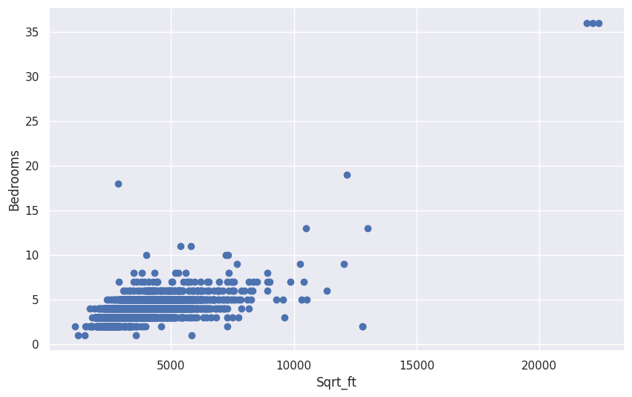
15
Created a scatter plot using Matplotlib to visualize the relationship between the two variables `Sqrt_ft` (presumably the square footage of properties) and `Bedrooms` (the number of bedrooms).
fig, ax = plt.subplots(figsize=(10, 6))# figure with dimensions and subplots
ax.scatter(df['Sqrt_ft'], df['Bedrooms']) #scatter plot is created
plt.title('Bedroom Distribution of Houses Sold')
ax.set_xlabel('Sqrt_ft') label set for x-axis
ax.set_ylabel('Bedrooms') label set for y-axis

Slide 19
16
Project Summary
Reading the Data: Use pd.read_csv() to read the data (5000 rows * 16 columns)
Handling Missing Values: Use df.isnull() or df.info() to detect missing data, then apply strategies like removing rows (df.dropna()), filling with mean/median/mode (df.fillna()).
Removing Duplicates: Identify and remove duplicate rows with df.duplicated() and df.drop_duplicates(), ensuring data consistency.
Data Type Conversion: Checked data types and no converted two columns to float (HOA, Fireplaces]
Outlier Detection: Detect outliers using statistical methods like Z-scores or IQR, and handle them by either removing or capping the values within a range.
Normalizing/Scaling Data: Scaled numeric columns using libraries like Pandas techniques to ensure features have similar ranges, improving model performance.
Clean Data : df.to_csv('Cleaned_House_dataset.csv', index=True) to save the cleaned data in csv ignoring the indexes (4990 rows * 16 columns)
THANK YOU

